Slide 1


IOAA 2025
Telescope Round

Slide 2
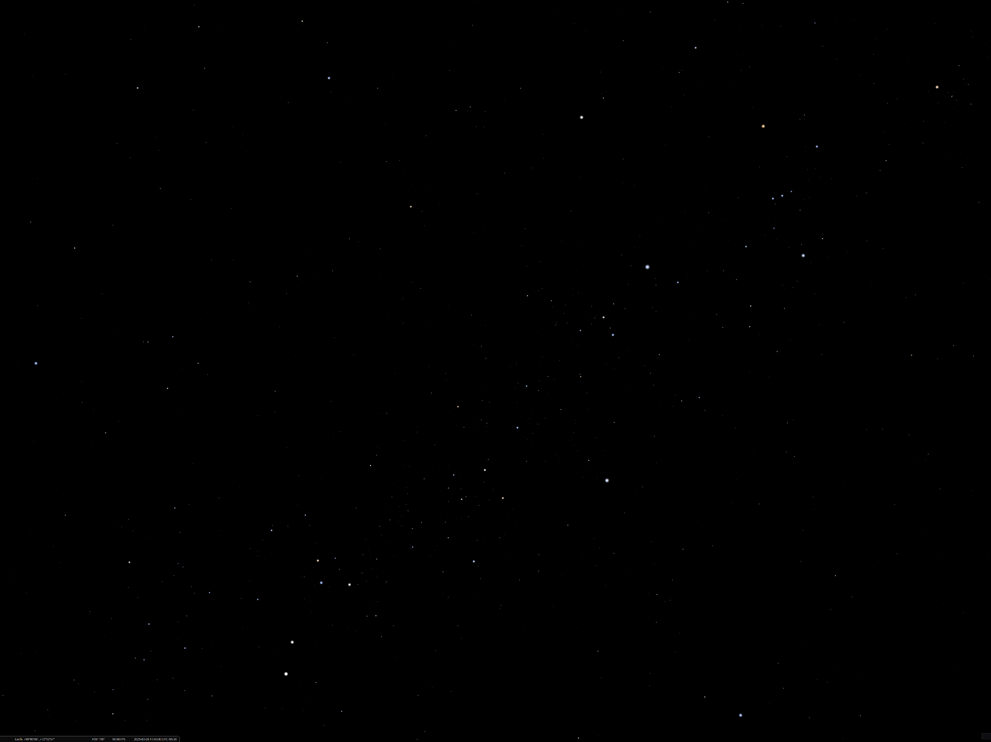
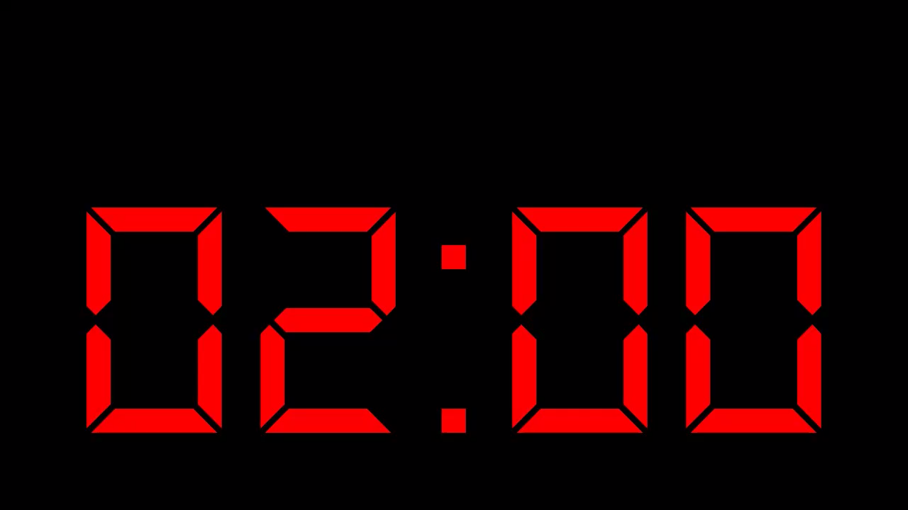
Sample Sky
Sample Sky

Slide 3
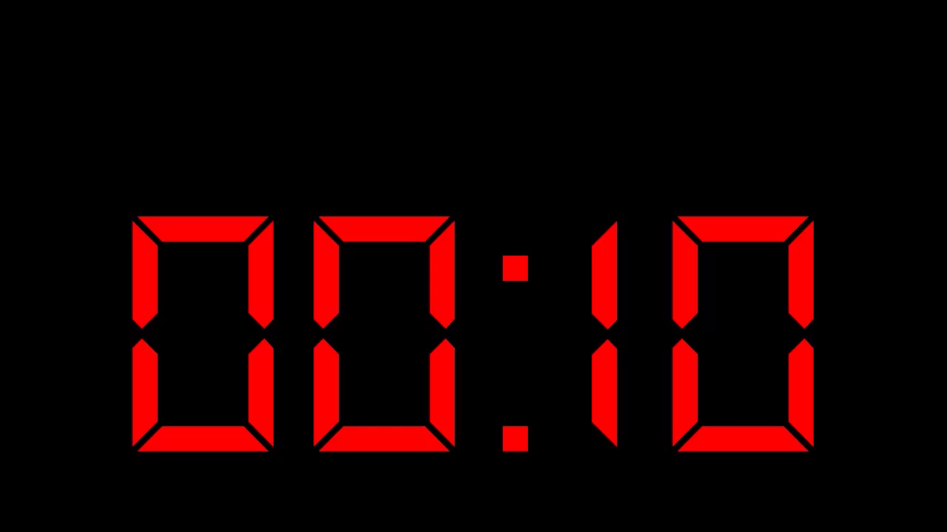
Q1 starts in

Slide 4
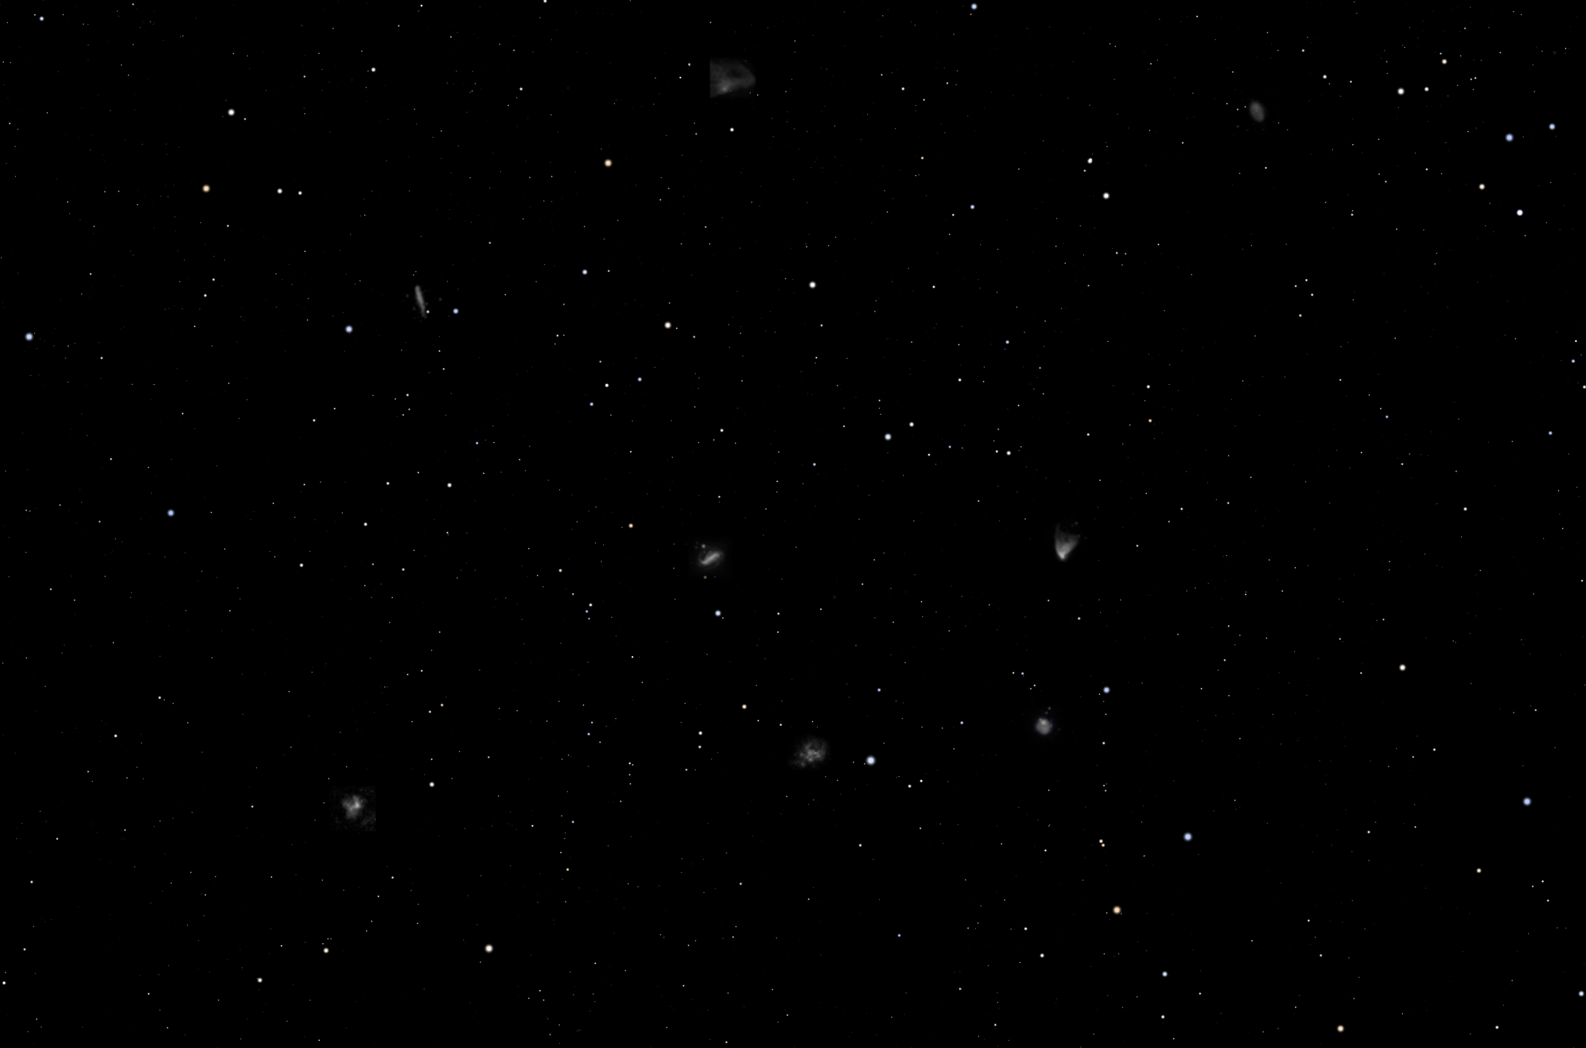

Slide 5
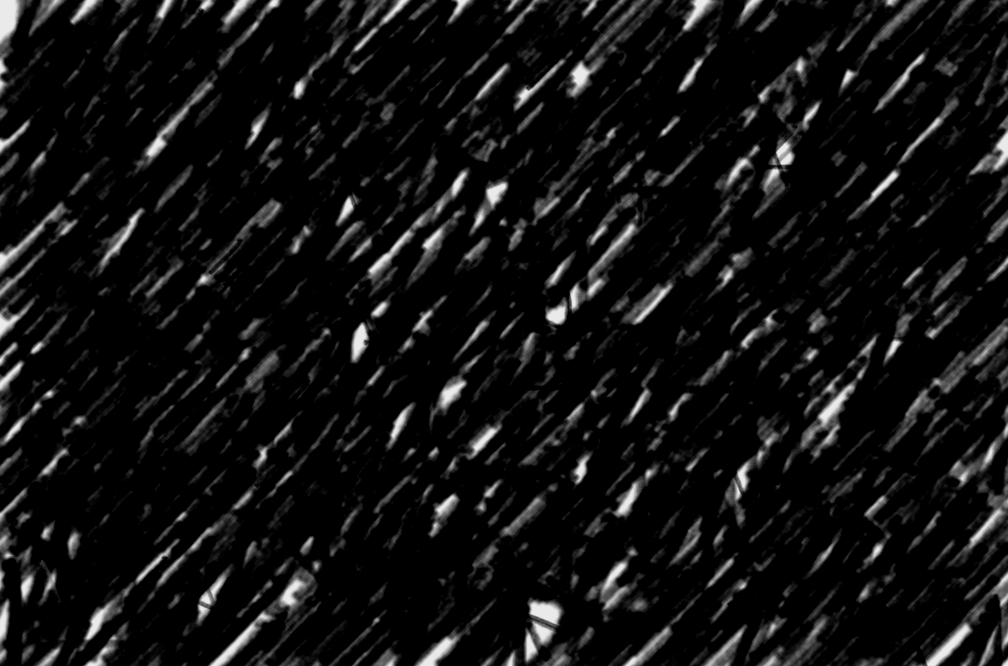

Slide 6
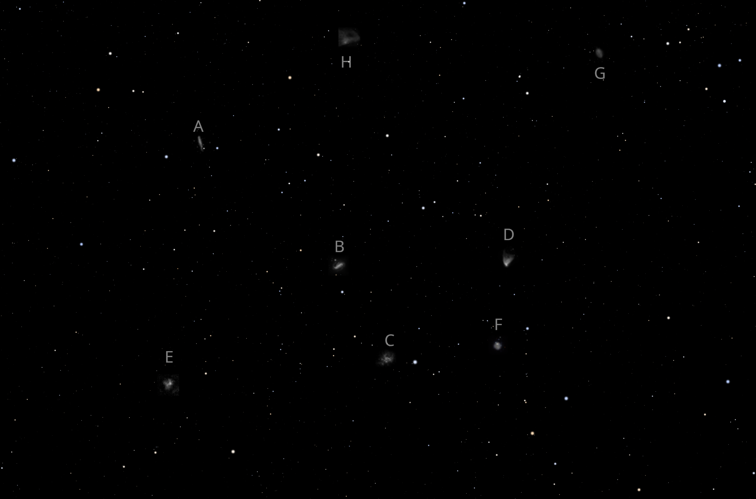

Slide 7
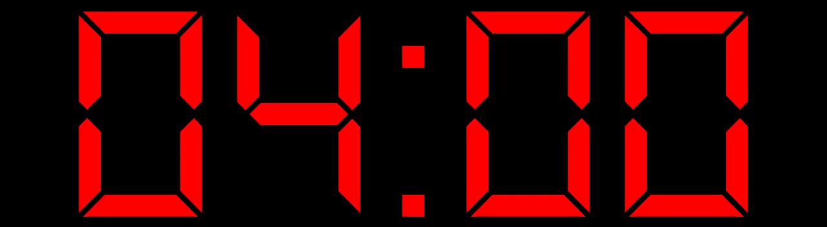
Break

Slide 8
Q2 starts

Slide 9
Run 1 starts in

Slide 10
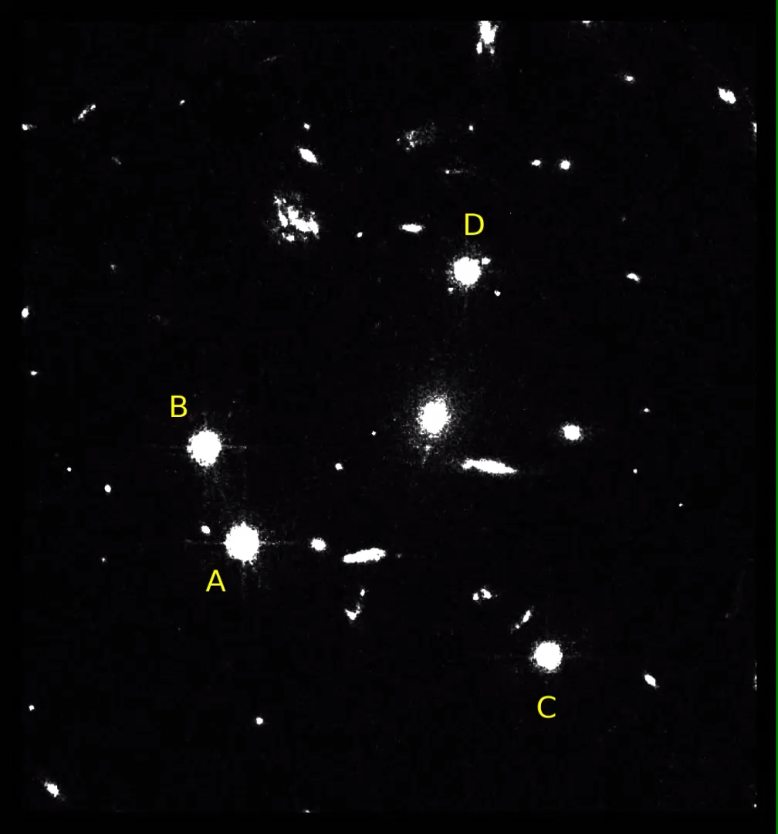
1

Slide 11
Run 2 starts in

Slide 12
2

Slide 13
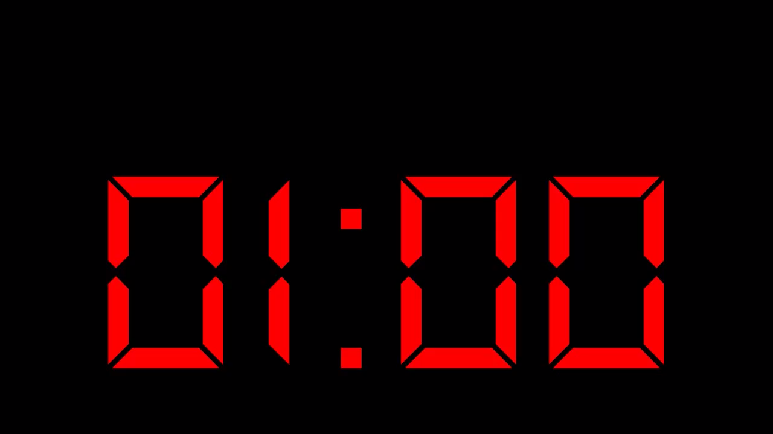
Run 3 starts in

Slide 14
3

Slide 15
Run 4 starts in

Slide 16
4

Slide 17
Run 5 starts in

Slide 18
5

Slide 19
Run 6 starts in

Slide 20
6

Slide 21
The End

